Slide 1
Destination Singapore
A data driven approach to attract visitors to spend in Singapore

Slide 2
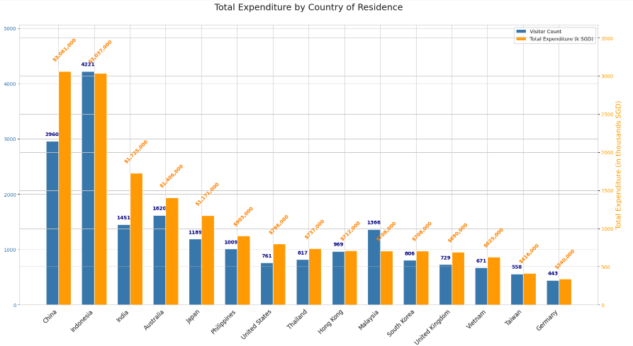
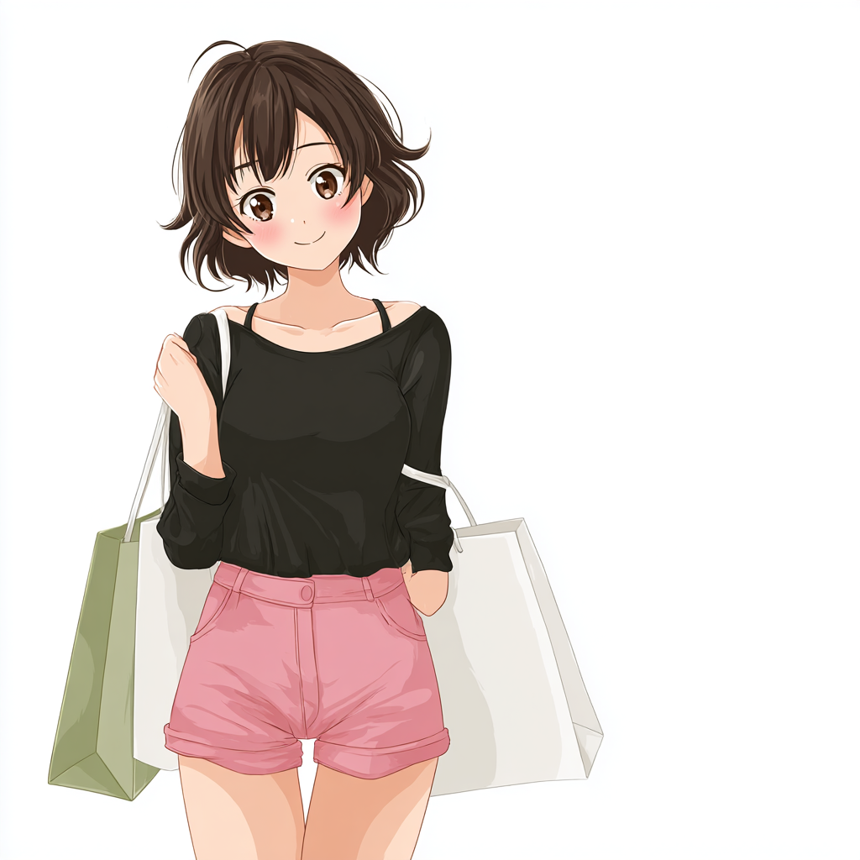
Who spends most in total?
In terms of total expenditure, visitors from China and Indonesia top the list.
Notes:
Why shop in Singapore? Consumption tax and VAT in China still make domestic prices higher than many overseas markets.Indonesia has PPnBM is a special tax imposed on luxury or non-essential goods, on top of VAT. PPnBM is a special tax imposed on luxury or non-essential goods, on top of VAT. On top of that, Indonesia’s import durites make imported luxury goods particularly expensive in Indonesia. Singapore has GST refund on top of of duty free goods in airports which makes shopping in Singapore for luxury goods more attractive.

Slide 3
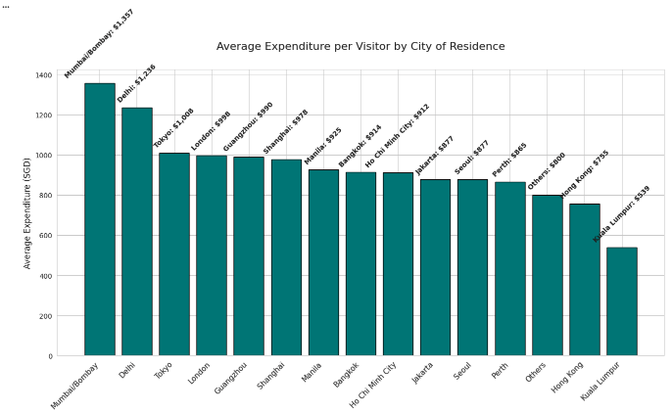
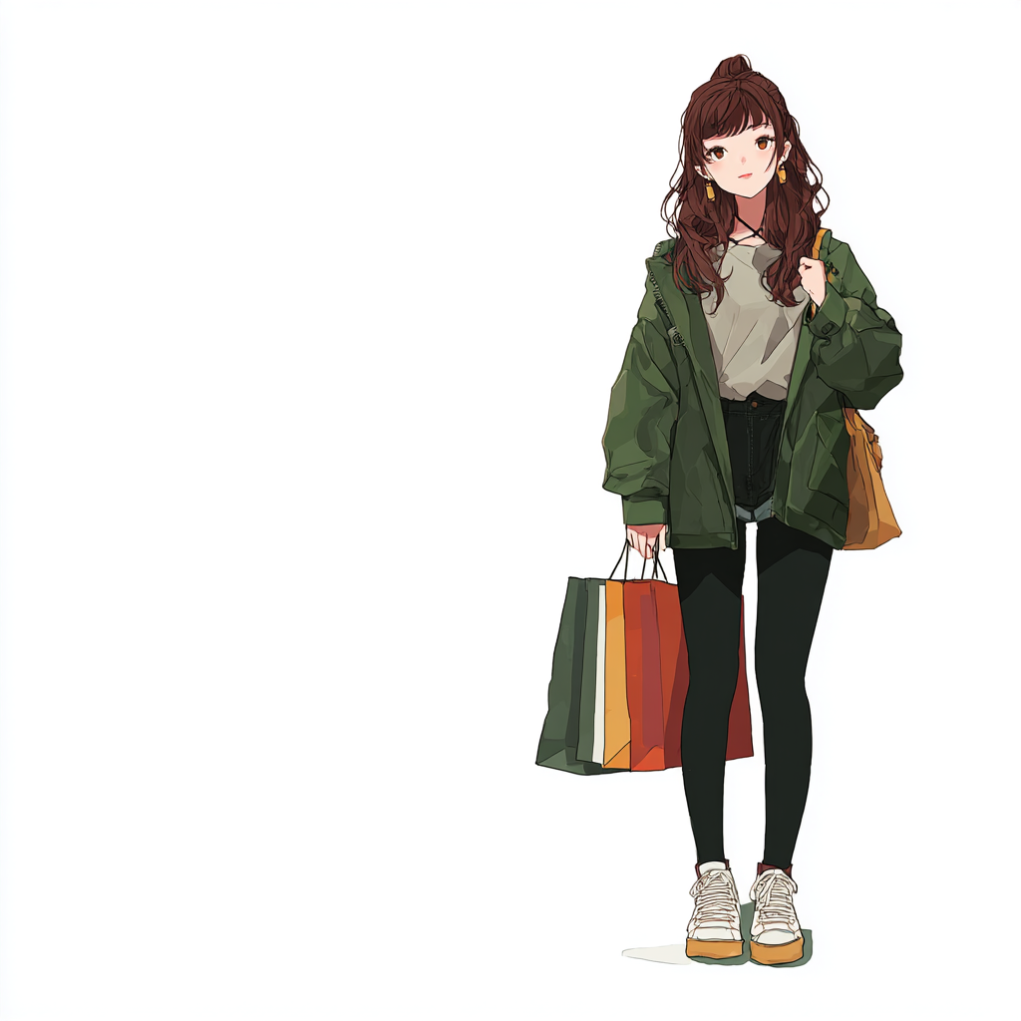
Which City spends the most?
Visitors from Mumbai, Delhi, and Tokyo spend the most on average.
Target these cities through social media ads in their native languages
Notes:
For digital campaigns, it might be worth buying Facebook, TikTok and social media ads to target Mumbai, Delhi and Tokyo as people from these cities spend the most. For Tokyo, it might be worthwhile to translate the ads to Japanese.

Slide 4
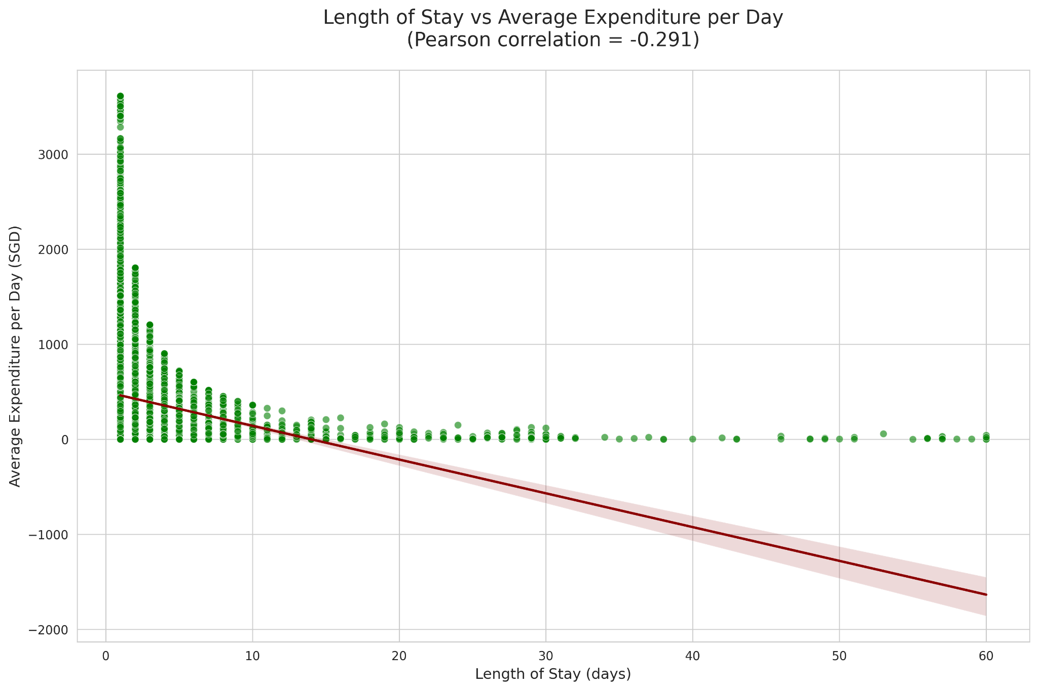
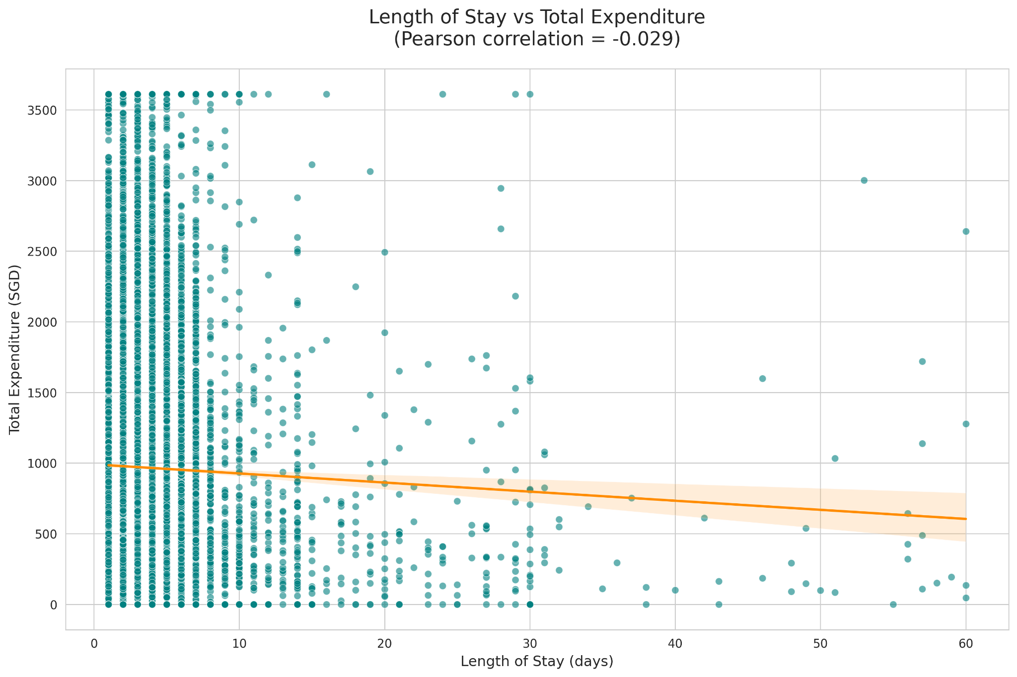
Does the Length of Stay affect spend?
The returns from each extra day stayed diminishes. We should focus on attracting short term visitors but get them to come often.

Slide 5
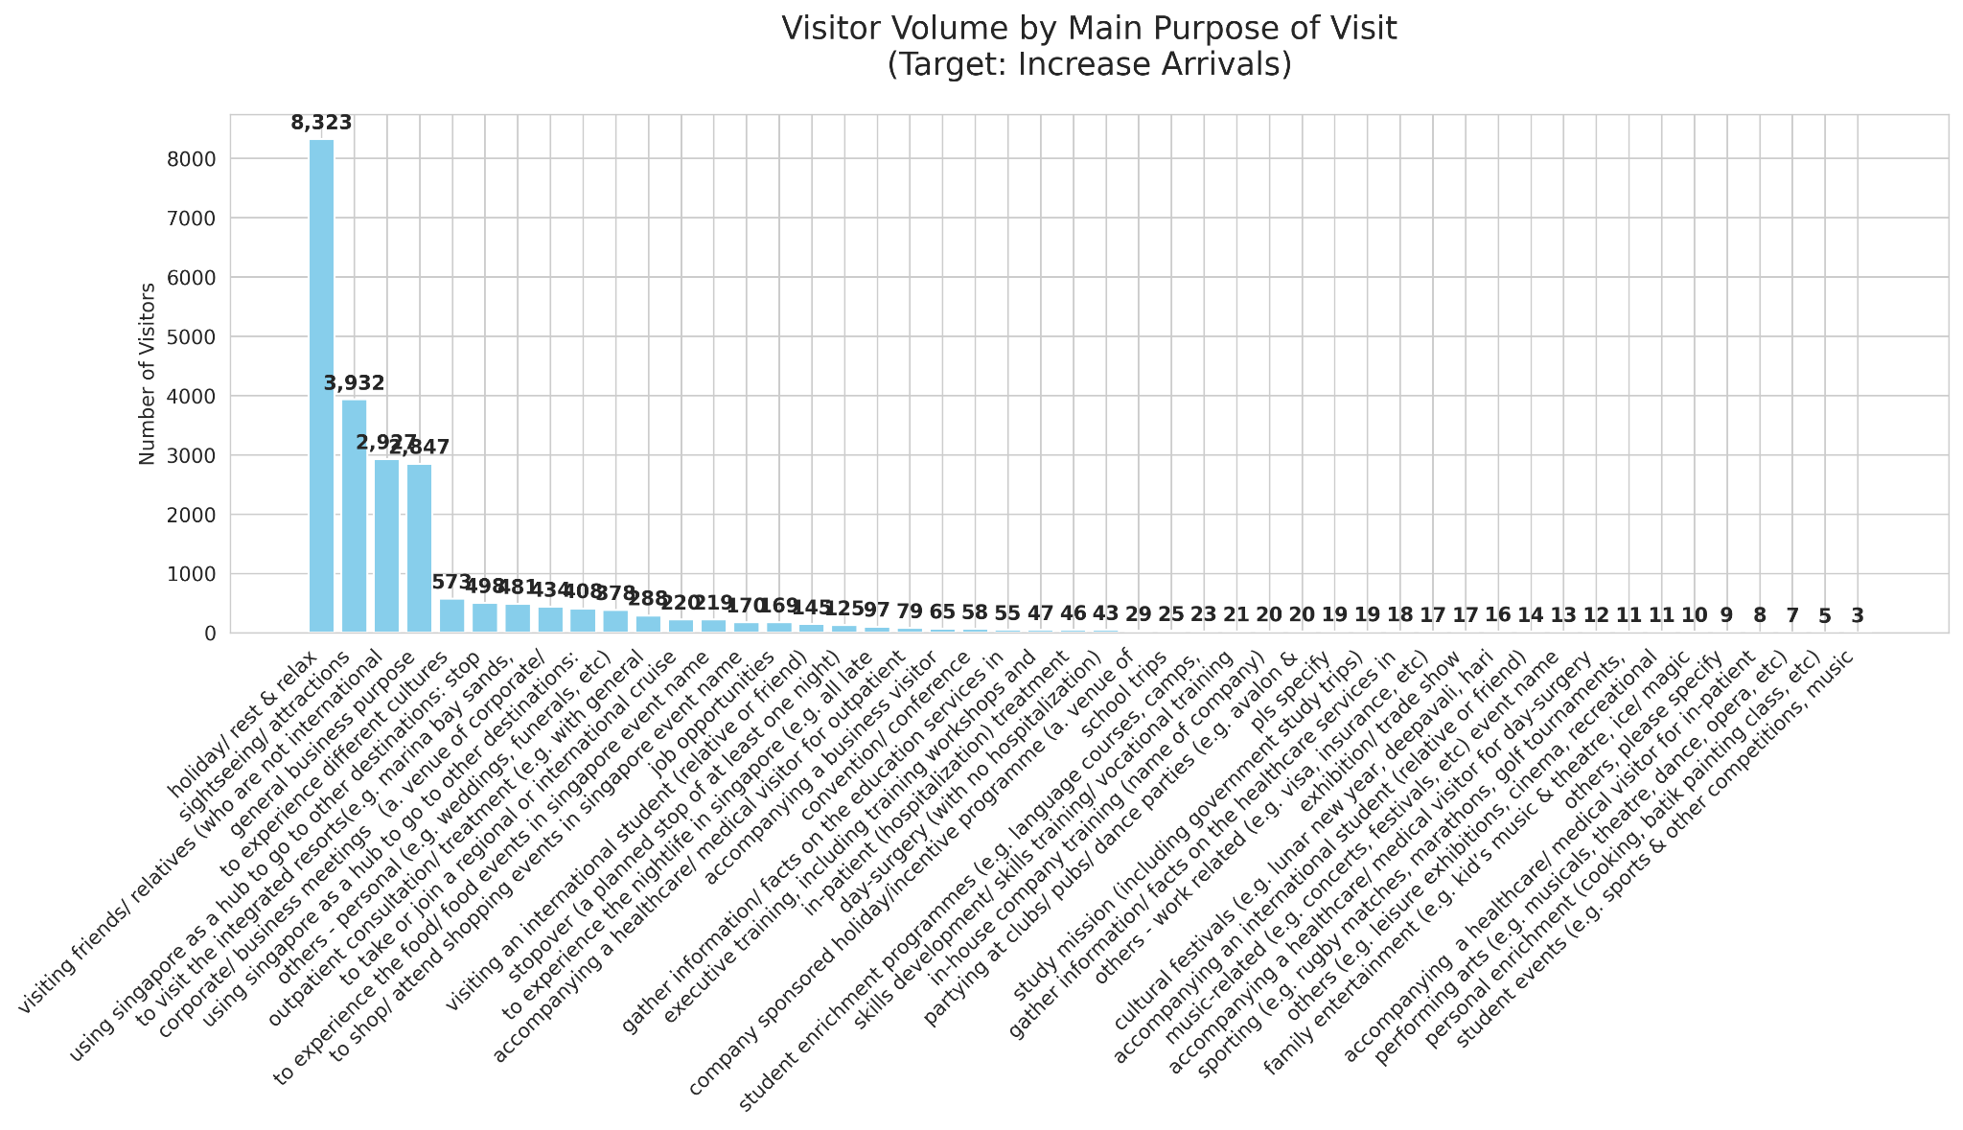
Why do people come to Singapore?
Most come for a holiday/ rest & relax

Slide 6
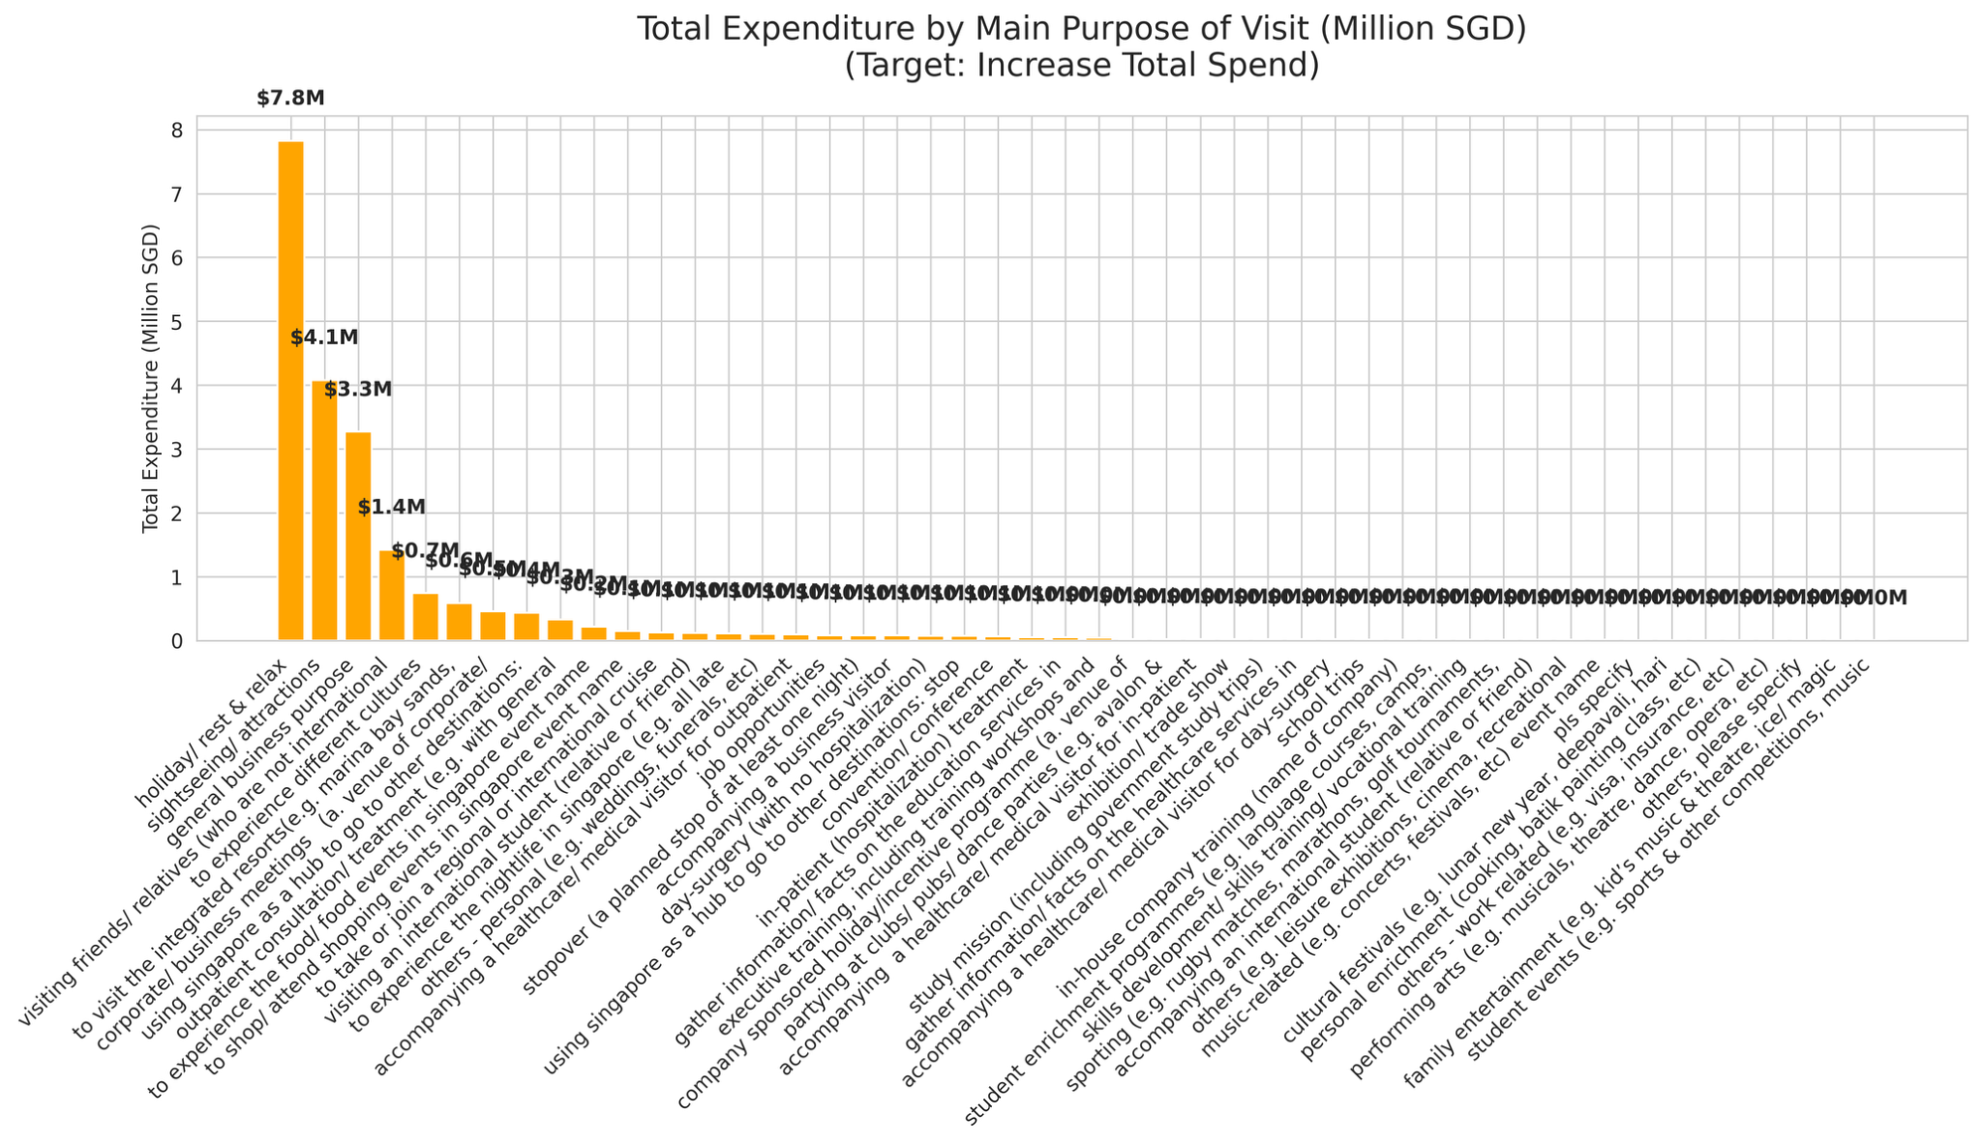
Main Purpose of Visit and the amount they spend in total
Most money is spent in total by people who are here for a holiday

Slide 7
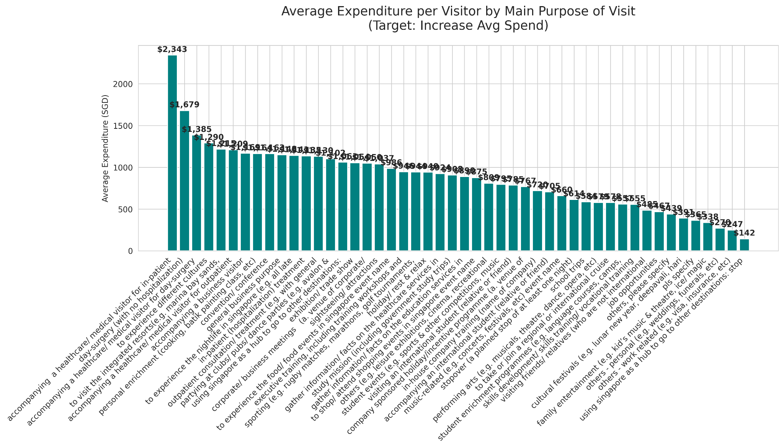
On average, based on why they visit, who spends most?
People here because of medical treatments spend the most on average

Slide 8
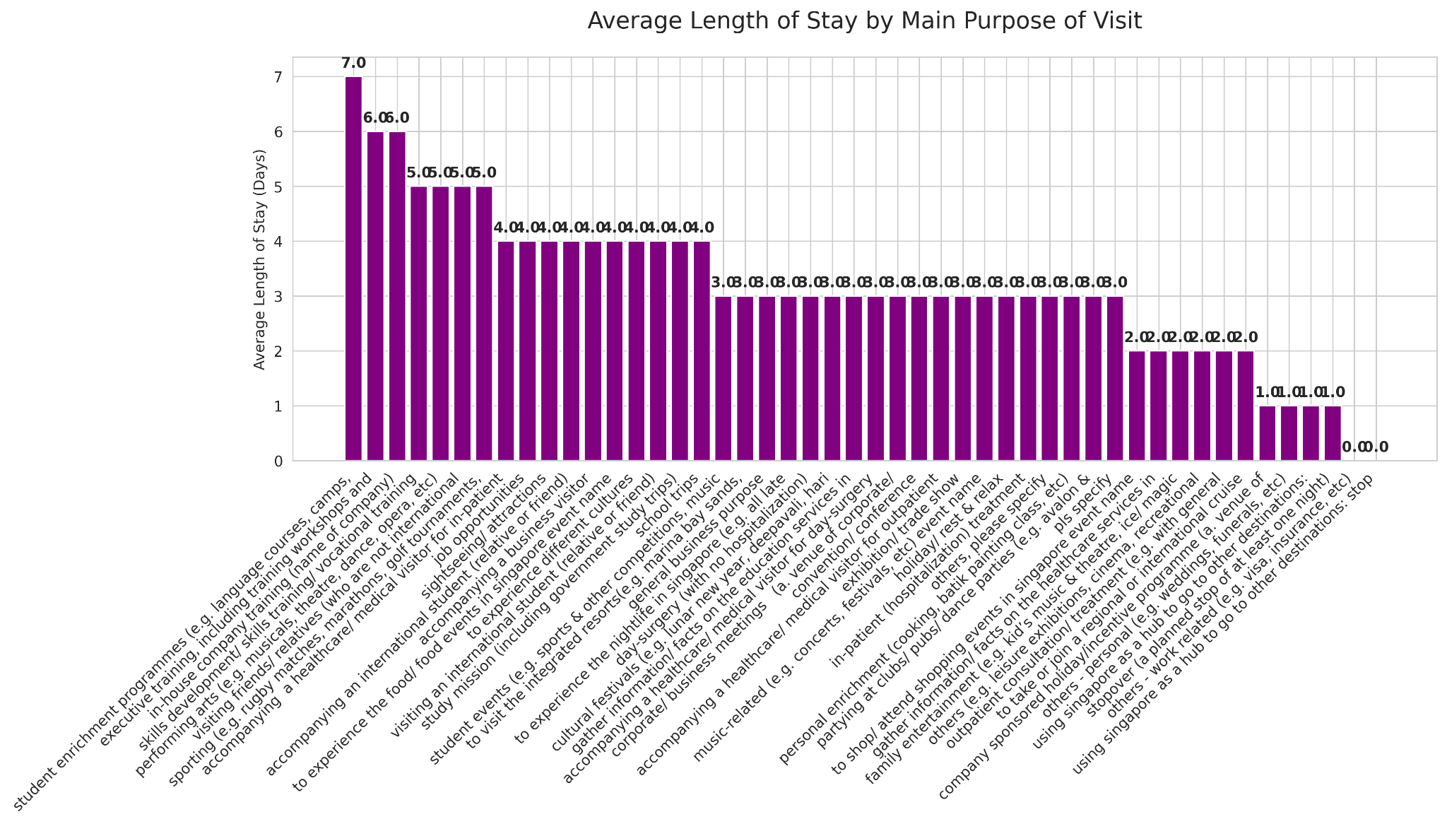
Who stays the longest based on the reason for their visit?
People who come here for training stay the longest on average : 7 days.

Slide 9
The most significant reasons people come to Singapore?
To take a break. (Holiday, rest & relax, sightseeing)
Medical treatments (as the patient or to accompany the patient)
For training (students, executives, company training, skill training)
Focus on Fun!
Shout out about our excellent healthcare!
Promote our educational resources!
Attract more visitors!

Slide 10
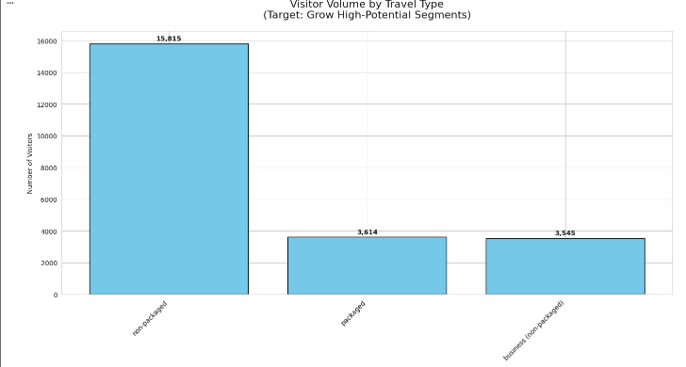

Most of our visitors do not follow any packaged tours and are not on here on business

Slide 11
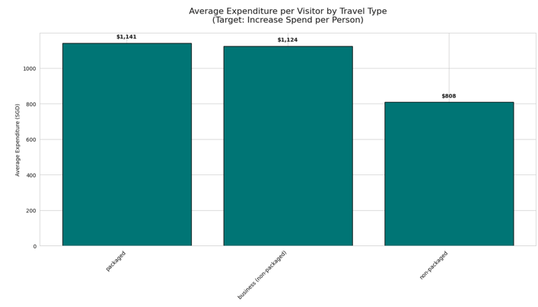

However these non-packaged tourists spend the least.
Those on packaged tours spend the most, followed by business travellers.

Slide 12
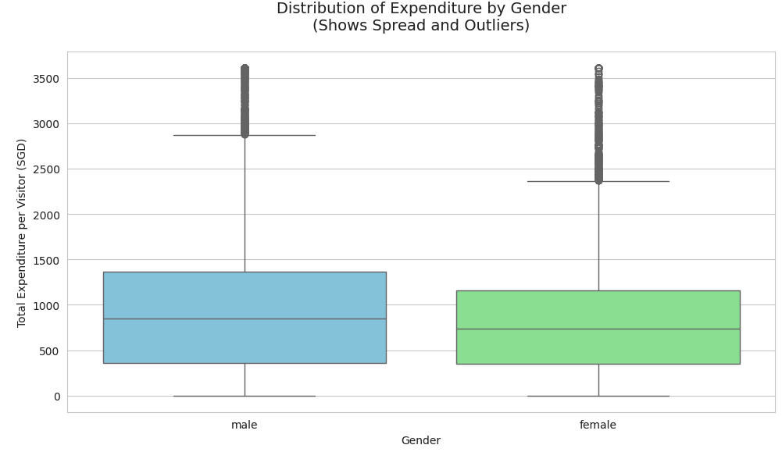
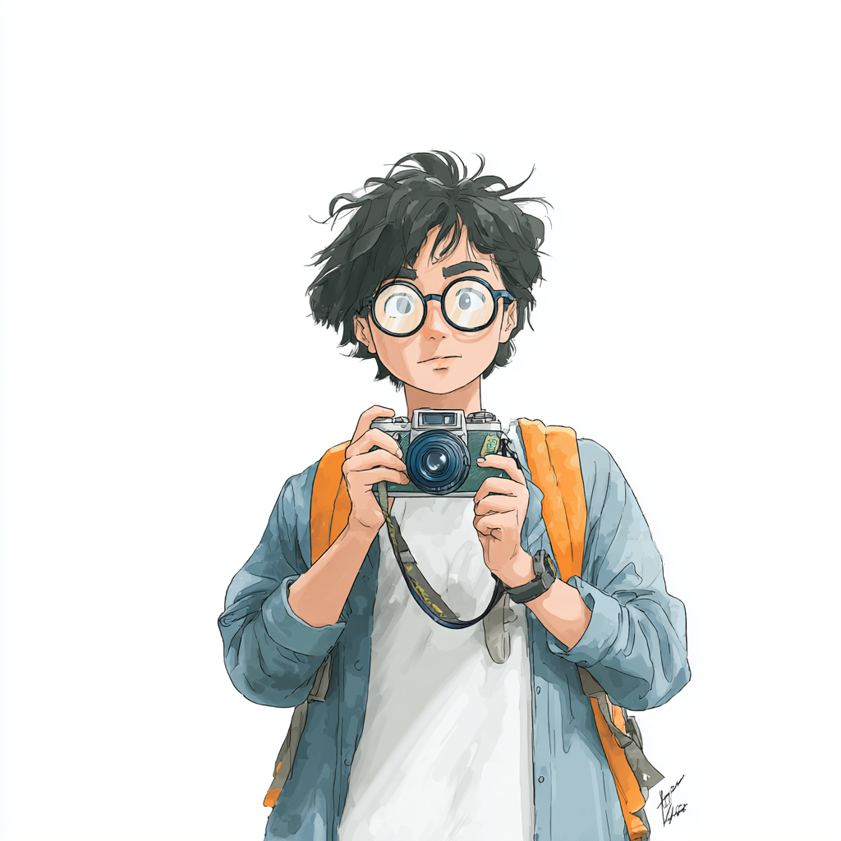
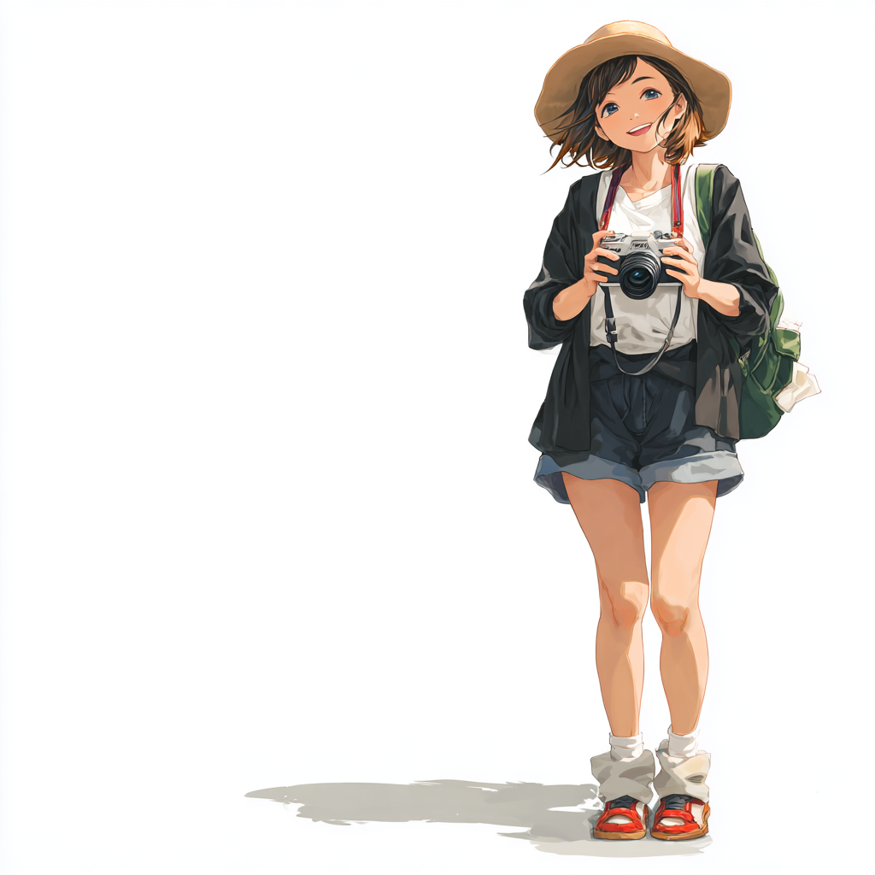
Guys vs Girls. Who spends more?
Most of the girls spend less and within a narrower spend range. But there are more higher spending outliers
Most of the guys spend more, within a wider spend range

Slide 13
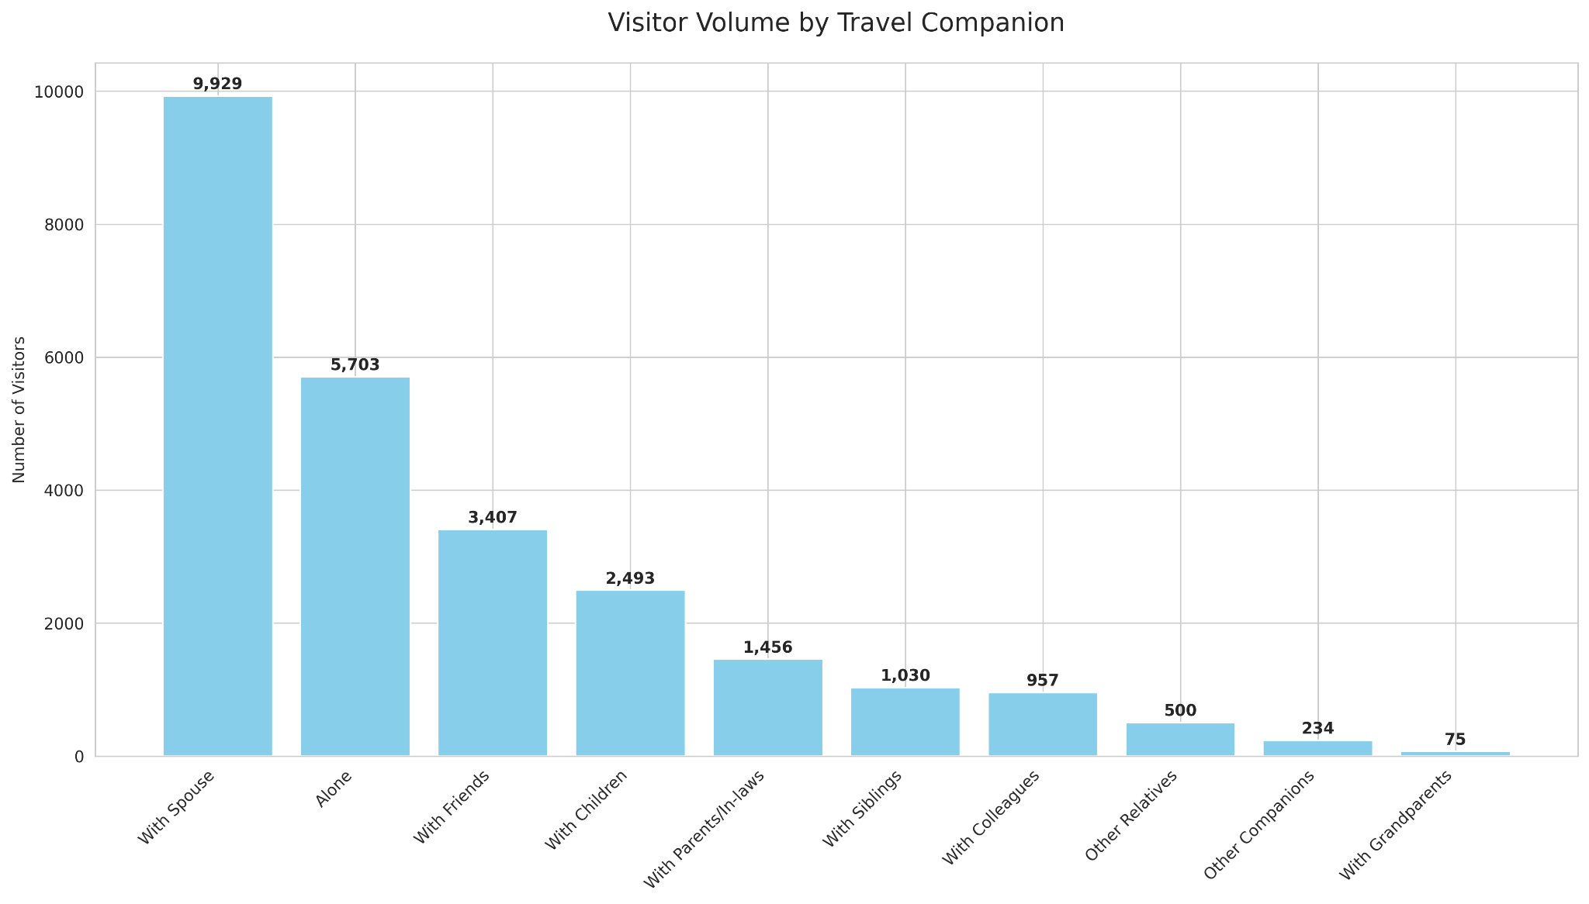

Who do they travel with most?
Most travel with spouse

Slide 14
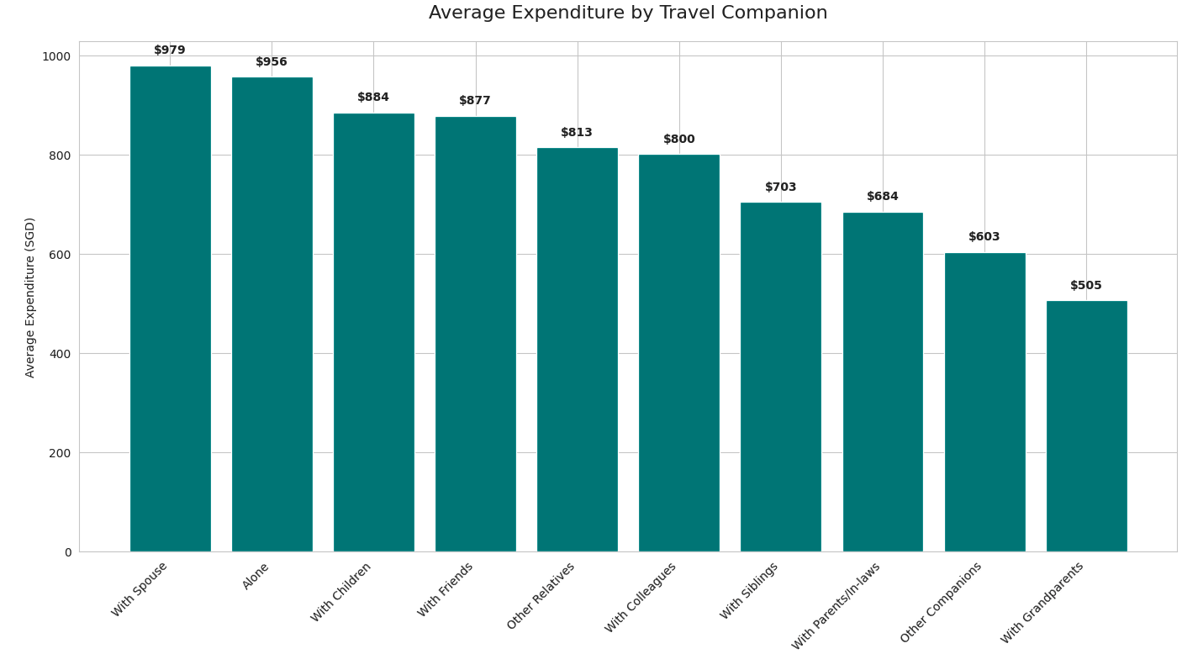
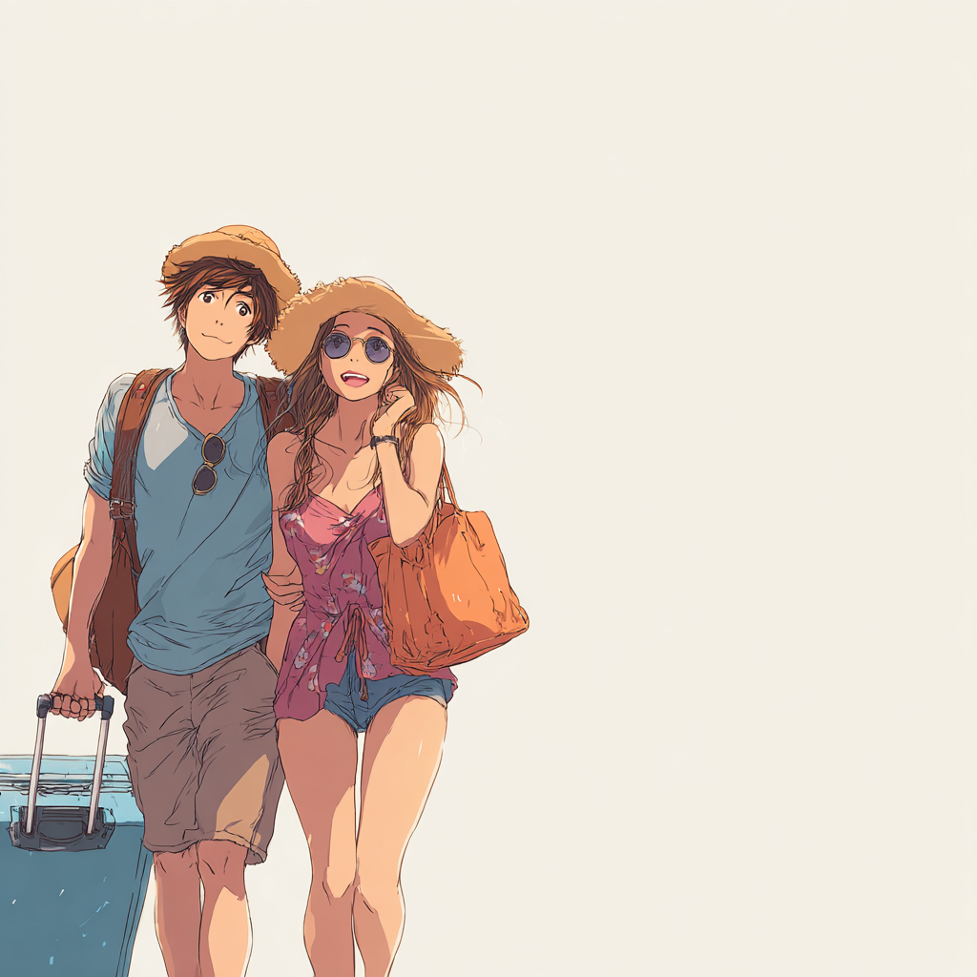
How much do they spend on average?
Couples
promos?
On average, they spend the most with their spouse. Solo travellers spend the next highest.

Slide 15
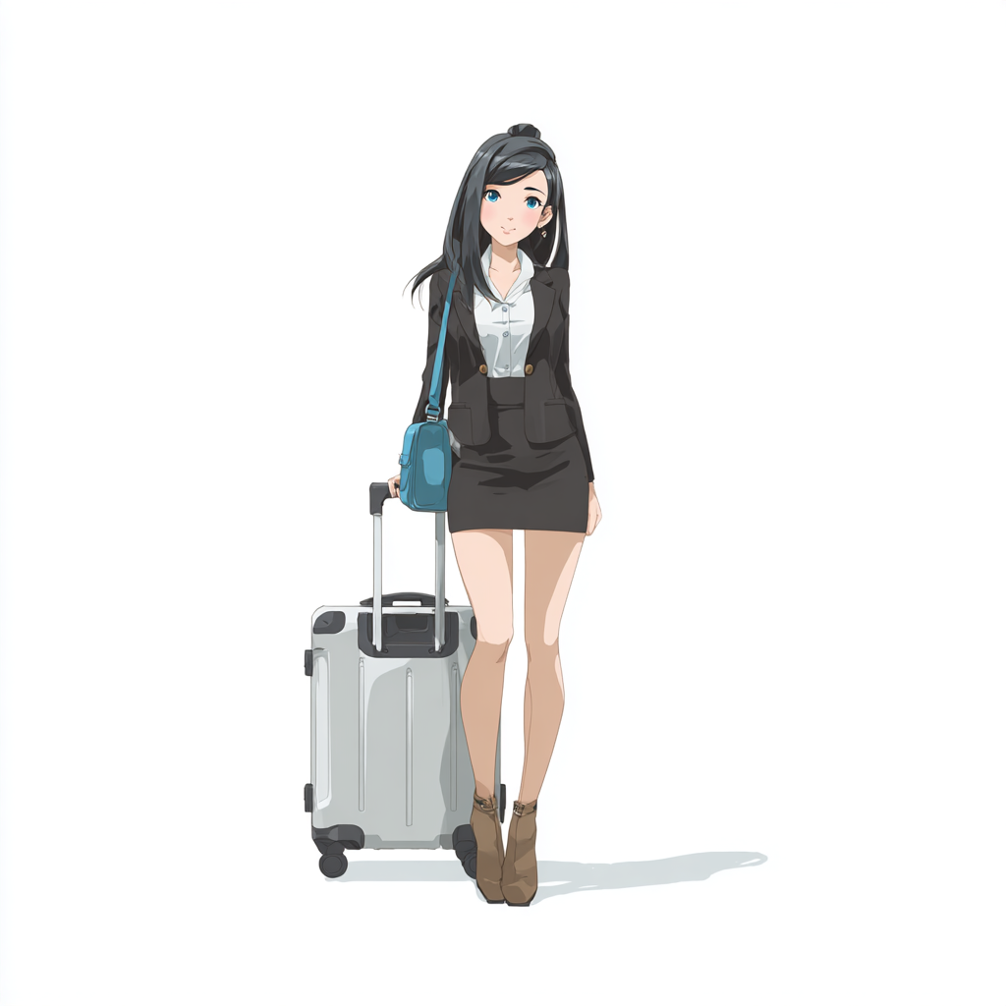


7 Personas
$
Repeat Leisure Visitors
Business Travelers
Budget Solo Explorers
Family Holidaymakers
High-Value Luxury Shoppers
Regional Short-Stay Shoppers
First-Time Cultural Seekers

Slide 16
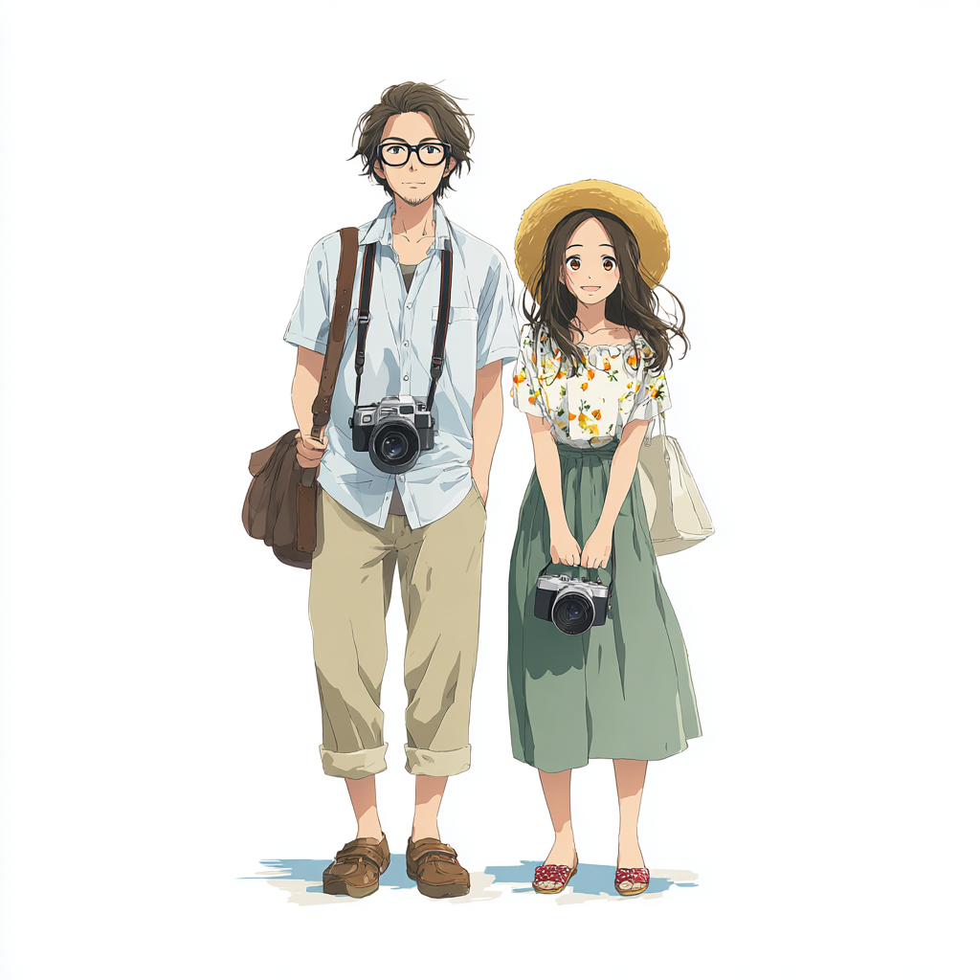
Repeat Leisure Visitors
• Size: 11,624 visitors (50.6%)
• Avg Spend: $531
• Top Origin: indonesia
• Main Purpose: holiday/ rest & relax
→ Marketing Focus: Buy Facebook, Youtube, Instagram and TikTok ads targeting people in Indonesia. Tailored campaigns in Indonesian language, partnerships with Bataam ferry terminals.
Promote MBS and all the luxury goods shopping to increase arrivals & spending. Shout out our GST refund for tourists. Take advantage of the taxes that make luxury goods far more expensive in China, Malaysia and Indonesia

Slide 17
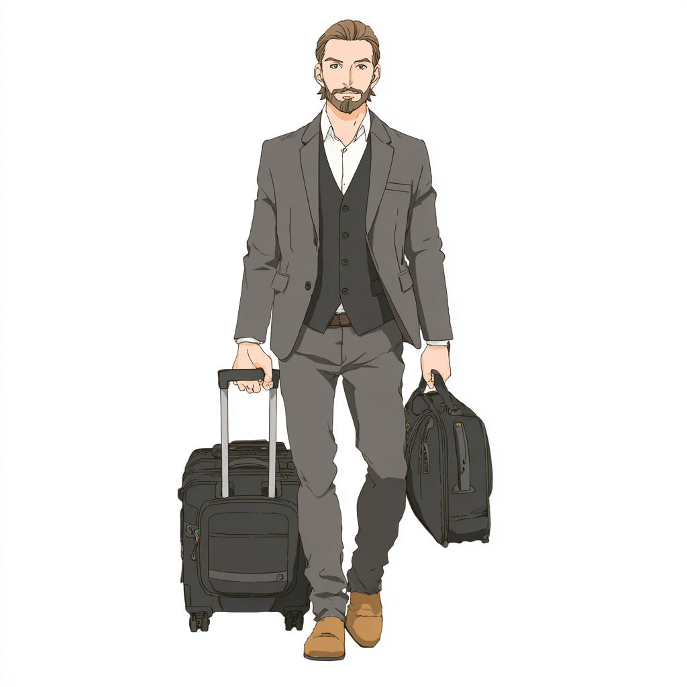
Business Travelers
• Size: 2,791 visitors (12.1%)
• Avg Spend: $1,761
• Top Origin: Other
• Main Purpose: general business purpose
→ Marketing Focus: Promote Singapore as THE place to do business.
Promote business conferences and events. Collaborate with telcos and hotels to provide free, secure wifi in hotels.
Hold international business networking events.
Collaborate with service providers to offer special discounts or privileges to businesses in a globally promoted campaign.

Slide 18

Budget Solo Explorers
• Size: 3,705 visitors (16.1%)
• Avg Spend: $1,126
• Top Origin: Other
• Main Purpose: holiday/ rest & relax
→ Marketing Focus: Offer practical freebies and discounts to incentivise budget solo explorers to come here.
Host networking events for visitors to explore quirky aspects of Singapore for example, durian tasting, bird watching, Katong tours, family history tours.
Collaborate with Singapore Citizens who are jobless or retired to create experiences for these solo travellers and a side income or business for these Singapore Citizens.

Slide 19

Family Holidaymakers
• Size: 1,141 visitors (5.0%)
• Avg Spend: $1,902
• Top Origin: china
• Main Purpose: holiday/ rest & relax
→ Marketing Focus: Child friendly activities that the entire family can enjoy. Promote these through content in Chinese, through Wechat and Douyin for China.

Slide 20
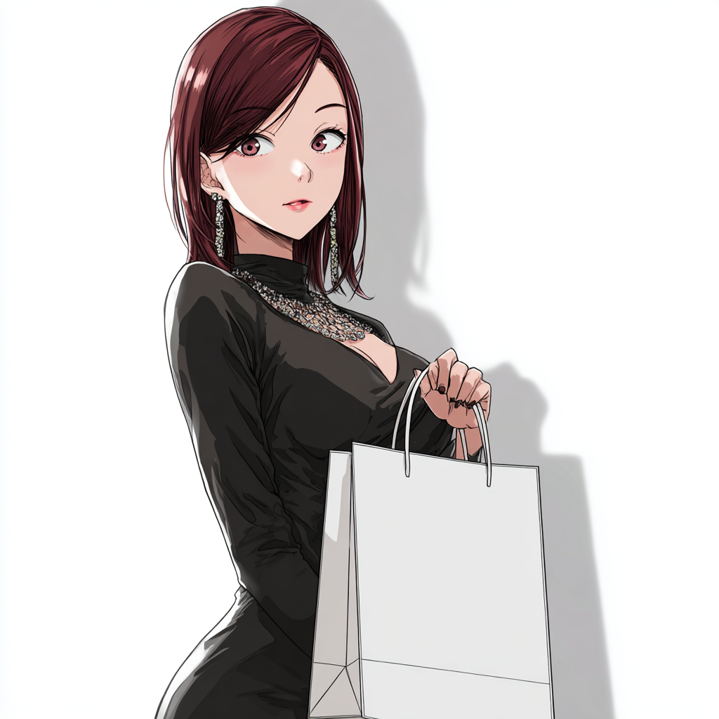
High-Value Luxury Shoppers
• Size: 2,812 visitors (12.2%)
• Avg Spend: $722
• Top Origin: indonesia
• Main Purpose: holiday/ rest & relax
→ Marketing Focus: Collaborate with MBS for promos for tourists. Run digital campaigns (buy Youtube, Facebook, Instagram and Tiktok ads targeting Indonesia) in English, Malay and Chinese languages to reach the target audiences to attract them to our shopping paradise for imported luxury goods.
Collaborate with Channel 8 actors and actresses to attract rich Indonesian Chinese to Singapore for meet the stars events with wine tasting and luxury goods discount shopping.

Slide 21

Regional Short-Stay Shoppers
• Size: 460 visitors (2.0%)
• Avg Spend: $1,585
• Top Origin: china
• Main Purpose: holiday/ rest & relax
→ Marketing Focus: 3 day sale, flash sale, shopping trips with big one day only bargains to spur impulse buys and drive these shoppers into a buying frenzy. Market these promos ahead of time through word of mouth, ads in china, Wechat, Douyin, Weibo, Xiaohongshu and Bilibili

Slide 22

First-Time Cultural Seekers
• Size: 441 visitors (1.9%)
• Avg Spend: $1,578
• Top Origin: Other
• Main Purpose: holiday/ rest & relax
→ Marketing Focus: Bring in world renown artists to perform in Singapore Consider bringing in performances like Les Miserables, Phantom of The Opera, groups like Il Divo, Korean Boy Bands and other cultural draws to attract more such visitors. Promote these shows months in advance through social media, before the tickets are released.

Slide 23
Thank you
I hope these insights will help you attract more visitors and increase their spend in our Lion City

